Slide 1
Databases for knowledge discovery
IN705 DB3 2018 - Session 12.1
Notes:
So far, we have explored databases primarily as a means of keeping track of actions involving data as they happen.
For example, we have thought about recording an order in the AdventureWorks database, or noting a vet’s visit in the Wildlife Park, or issuing a piece of music in the SMMC
But databases can actually be used for a larger (and more interesting) class of work.
As the organised repositories for large quantities of data, they can be used not only to record data actions, but to learn things about the data context represented by those actions, under different circumstances, and over time.
This exploration requires special tools that you either program yourself, or which come with the database
In this session we will talk about the issues. Next time we will look at some tools for this work.

Slide 2
Two Types of Processing
OLTP:
On-line transaction processing
OLAP:
On-line analytical processing
Notes:
OLTP: what we have been doing
OLAP: statistical methods for exploring databases looking for truth.
A single business often has both OLTP and OLAP.
Think of Telecom.
They have OLTP where they send out bills, cap your bandwidth, etc.
They might also use OLAP to look at patterns of customer behaviour, like what sorts of users are most likely to switch to another vendor.
Naturally, the correct architecture for OLTP and for OLAP are different.
Let’s look at some of those differences.
(The following slides are based on a table from www.rainmaker.com)

Slide 3
OLTP vs. OLAP
 | OLTP | OLAP
Source of data | Operational data INSERT, DELETE, UPDATE queries | OLTP data consolidated over time and often from multiple sources
Notes:
These slides based on a table from www.rainmaker.com

Slide 4
OLTP vs. OLAP
 | OLTP | OLAP
Purpose of data | To enact essential business tasks | To provide information for problem solving and business decision support
Notes:
These slides based on a table from www.rainmaker.com

Slide 5
OLTP vs. OLAP
 | OLTP | OLAP
What the data show | A snapshot of the current state of the business | Multi-dimensional views of current and historical business activities
Notes:
We will discuss what a “multi-dimensional view” is in a moment.
But if you know what a pivot table is, you’re pretty close.

Slide 6
OLTP vs. OLAP
 | OLTP | OLAP
Inserts and Updates | Frequent Short and fast Performed by end-users | Rare Large and slow Serves to update the contents of the OLAP data
Notes:
As we said, the OLAP data is a collection of OLTP data
As more OLTP data is created, it needs to be added to the OLAP database

Slide 7
OLTP vs. OLAP
 | OLTP | OLAP
Queries | Simple Standardised Generally return small records sets | Complex Involve aggregations Return information about patterns in the data
Notes:
As we said, the OLAP data is a collection of OLTP data
As more OLTP data is created, it needs to be added to the OLAP database

Slide 8
OLTP vs. OLAP
 | OLTP | OLAP
Processing Speed | Fast Typically seconds | Can be very, very slow May take many hours
Notes:
As we said, the OLAP data is a collection of OLTP data
As more OLTP data is created, it needs to be added to the OLAP database

Slide 9
OLTP vs. OLAP
 | OLTP | OLAP
Space Required | Can be fairly small if historical data is archived Mb to a few Gb | Large May contain enormous quantities of data May contain many, many indexes Often Tb
Notes:
As we said, the OLAP data is a collection of OLTP data
As more OLTP data is created, it needs to be added to the OLAP database

Slide 10
OLTP vs. OLAP
 | OLTP | OLAP
Database design | Relational 3rd normal form | May be denormalised More complex architectures, e.g. star and snowflake schemas
Notes:
We will look at the schemas later

Slide 11
OLTP vs. OLAP
 | OLTP | OLAP
Backup and Recovery | Rigorous backup protocol required Availability essential to business function Data loss can be catastrophic | Relaxed Availability can be more flexible If required, OLAP database can be reconstructed from OLTP sources

Slide 12
OLAP System Elements
Data Warehouse
OLAP data store
Data Warehouse Analysis Tools
Multi-dimensional data summaries
Data Mining Analysis Tools
Pattern recognition algorithms for predictive analyses
Notes:
Sometimes the whole system is referred to as “business intelligence”.

Slide 13
Data Warehouse
Originally defined as:
“An integrated, subject-oriented, time-variant, nonvolatile collection of data”
Inmon
Notes:
An OLAP database, or data warehouse, is different from the databases we work with.
These are its essential properties

Slide 14
Data Warehouse
Integrated:
Data drawn from multiple sources and consolidated in a single database
Can introduce enormous “data cleaning” problems
Notes:
Integrated
Data from the entire organisation
So telecom’s phone customer database and internet customer database would be combined here.
Or the item purchase data from North Island New World stores and South Island New World stores.
Or data from Honda’s sales and repair sites.
Or all the universities studying global warming
Data cleaning problems.
For example, the sales and repair databases for the same car might have different addresses for the owners. Or different spellings of their names.
South Island grocery stores might say “courgettes” while North Island say “zucchini”
If you are a multinational aggregating from different countries, you will have different date formats, and languages

Slide 15
Data Warehouse
Subject-Oriented
Data are organised by topic
Notes:
Subject-Oriented
Sales, marketing, repairs, finance are more important concepts than “invoice”
This often leads to denormalisation and aggregation of tables to improve performance.
Note that this isn’t a requirement, you can do OLAP on a 3rd normal form database, but for a large production data warehouse, restructuring would probably be necessary to improve efficiency.

Slide 16
Data Warehouse
Time-Variant
Data uploaded repeatedly over time
Historical data maintained
Time-based aggregates (e.g. “weekly sales”) recomputed at data upload
May contain “future data”
Notes:
Future data are projections of what will occur in the future
These are computed using data mining techniques

Slide 17
Data Warehouse
Non-volatile
Once data are entered into the warehouse, they are never removed.
Notes:
These is no such thing as archiving out the old part of the data warehouse.
Since we often use it to look at trends over time, we need all the time we can get data about
This of course implies that storage requirements for data warehouses are monotonically increasing, and can become overwhelming

Slide 18
Creating the Data Warehouse
OTLP Databases
Data Preparation
OLAP Data Warehouse
Extract
Filter
Clean
Transform
Integrate
Classify
Aggregate
Summarise
Notes:
Figure based on Rob and Coronel
Note that you will also hear the term “data mart”. This generally refers to a small, single subject data warehouse.

Slide 19
Data Warehouse Analysis Tools
Multi-dimensional analysis
Data are processed and viewed as part of a multi-dimensional structure
Notes:
Same as a pivot tables in Excel, but with lots more data.
Remember to mention that “the cube” is a conceptual organisation, not a physical one.
Different OLAP systems organise the underlying data in different ways.

Slide 20
Multidimensional Data
Facts:
Values
Dimensions
Qualifying properties that have an effect on facts
Attributes
Descriptive characteristics of a dimension
Multidimensional analyses look for the effect of dimension attributes on facts
Notes:
The database structure is different than the OLTP.
Usually a tool is involved which “gets a snapshot of a relational database management system data and then re-composes this data into multidimensional data.”
One of the major distinctions of MOLAP against a ROLAP tool is that data are pre-summarized and are stored in an optimized format in a multidimensional cube, instead of in a relational database.
In the multidimensional conceptualisation, there are three important parts
Facts (dependent variables)
Values: Price, harvest weight, units sold, repairs required
Dimensions (factors or independent variables)
Product, type of plant, geographic region, type of use.
Attributes (levels sort of)
Region dimension=> country, province, city, store
Product dimension => product ID, product type, size, colour,
So, for example, we might want to know if the distribution/pattern of car repairs (fact) is different depending on city (attribute implementing a region dimension).
Or we might want to know if the likelihood of transferring to another ISP (fact) is different for people on the different usage plans (attribute defining a usage dimension)

Slide 21
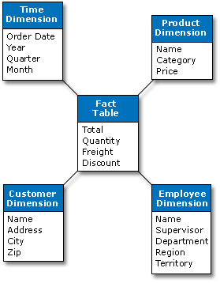
Star Schema
Notes:
Instead of modelling the data as an ERD, when designing a data warehouse, one models the data in terms of the facts, dimensions and attributes of interest.
When diagrammed, the list of facts is in the centre, and the various dimensions with their attributes connect to it.
For the obvious reason, this is called a Star Schema.
Note that the physical layout of the data may or may not be starry. This is a conceptual model.
OLAP and MOLAP
“Traditional OLAP products are also called "multidimensional OLAP" (MOLAP) because they summarize transactions into multidimensional views ahead of time. Data are organized into a cube structure that can be rotated by the user, which is particularly suited for financial summaries. Queries are fast because the consolidation has already been done.”
“Relational OLAP (ROLAP) Relational OLAP tools extract data from relational databases. Using complex SQL statements against relational tables, ROLAP is able to create multidimensional views on the fly. ROLAP tends to be used on data that has a large number of attributes, where it cannot be easily placed into a cube structure. For example, customer data with numerous descriptive fields are typically ROLAP candidates, rather than financial data.”
OLAP servers
Relational OLAP (ROLAP):
extended relational DBMS that maps operations on multidimensional data to standard relational operations.
Multidimensional OLAP (MOLAP):
special purpose server that directly implements multidimensional data and operations
A single fact table and a single table for each dimension
Every fact points to one tuple in each of the dimensions and has additional attributes
Does not capture hierarchies directly
Generated keys are used for performance and maintenance reasons

Slide 22
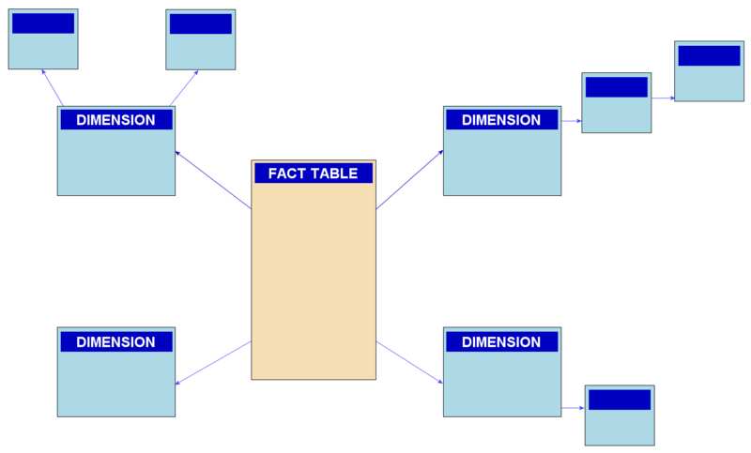
Snowflake Schema
Notes:
In some cases, the dimensions can get sufficiently complicated that you want to break them down into subcategories, or subelements.
At this point your star divides at the edges. Eventually it is a snowflake.
Mostly this distinction is a matter of degree
Represent dimensional hierarchy directly by normalizing the dimension tables
Easy to maintain
Saves storage, but is alleged that it reduces effectiveness of browsing (Kimball)
Again note that the physical implementation may or may not reflect this. In practice, underlying structure can be complex as special techniques are used to improve performance. Beyond scope. See for references

Slide 23
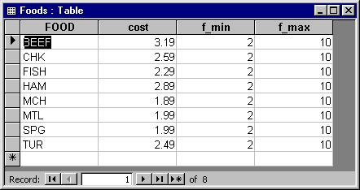
Multidimensional Data
One dimension:
Notes:
Example – Relational tables show data in one dimension. That is they describe one single determinant of a data value (i.e. what record it is in)
2D pivot table = 2 dimensions. “If it’s this kind and this kind, then it has this value”
Cube = 3 dimensions
Etc.

Slide 24
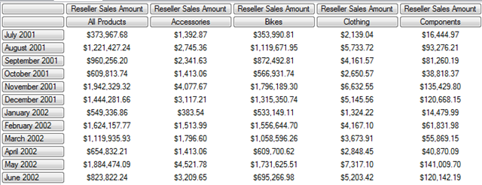
Multidimensional Data
Two dimensions:
Notes:
2 dimensions. “If it’s this kind and this kind, then it has this value”
For example, here , you could look at the pattern of sales as a function of the time dimension and the product dimension
How does this particular product vary over time?
What did the different products do at this time?
And, was the time pattern the same for all the products (2-way interaction)
OLAP systems, when presenting a two-dimensional data representation, often show row and column means or other summary
So, it should be straightforward to extend to three dimensions.
Imagine that you wanted to look at sales as a function of time, product and store location. For that, you need a cube

Slide 25
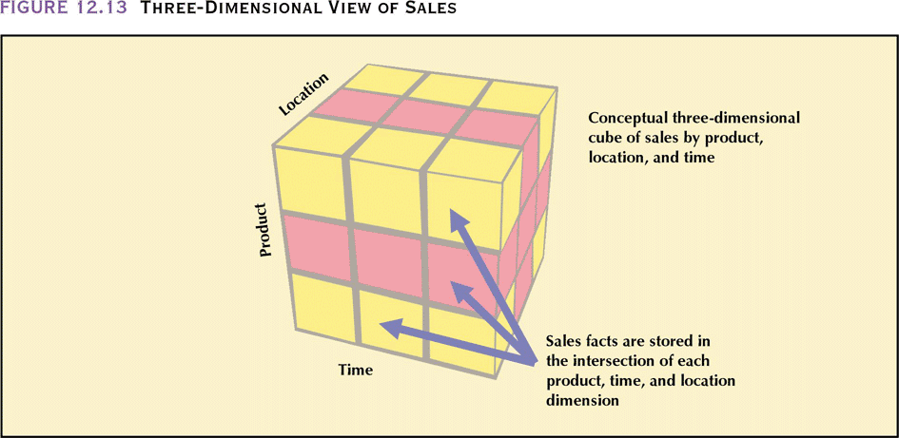
Multidimensional Data
Three dimensions
Notes:
And, if you have many dimensions, there’s no reason that you can’t have 4, 5, ...n-dimensional data representations
Time x Product x Location x Marketing Campaign
Since we can’t think in four dimensions, we can imagine the fourth dimension as multiple cubes, one for each attribute level of the 4th dimension
And multiple 4ths to make a 5th, and so on.

Slide 26
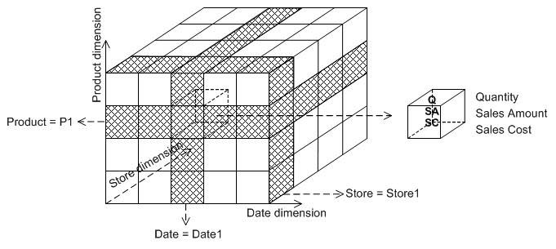
Multidimensional Data
Notes:
Note that we can of course be interested in more than one fact at a time
This illustration shows product x store x time for three different metrics – quantity, sales amount and sales cost

Slide 27
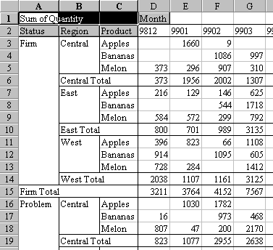
Displaying Multidimensional Analyses
Notes:
Products have various ways of doing this.
A common method is with this pivot table style...
Other products provide more elaborate features...

Slide 28
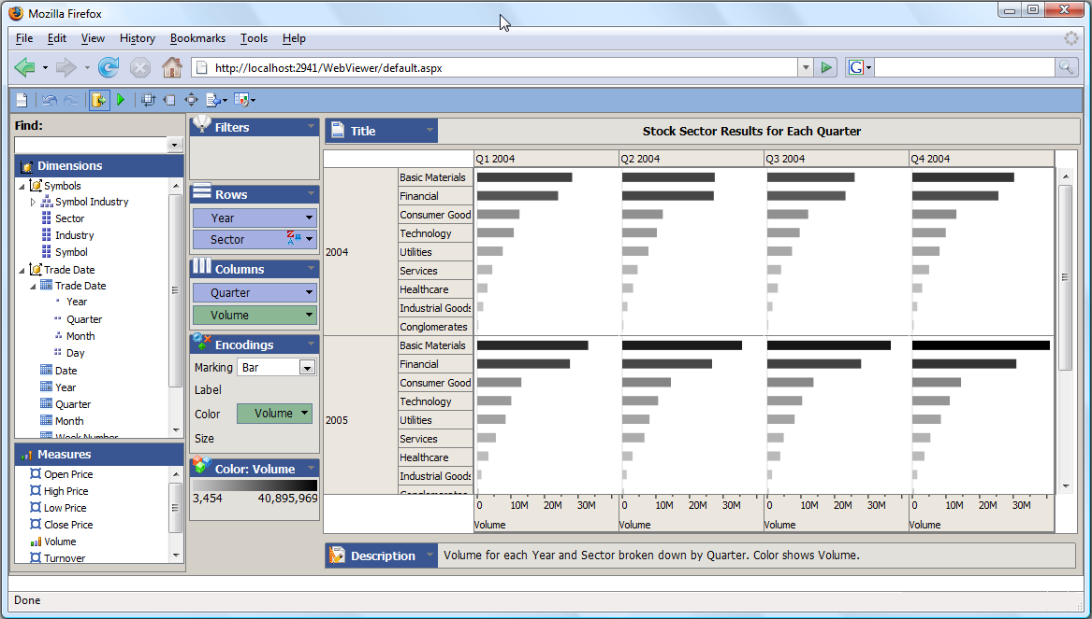
Displaying Multidimensional Analyses
Notes:
SQL Server OLAP

Slide 29
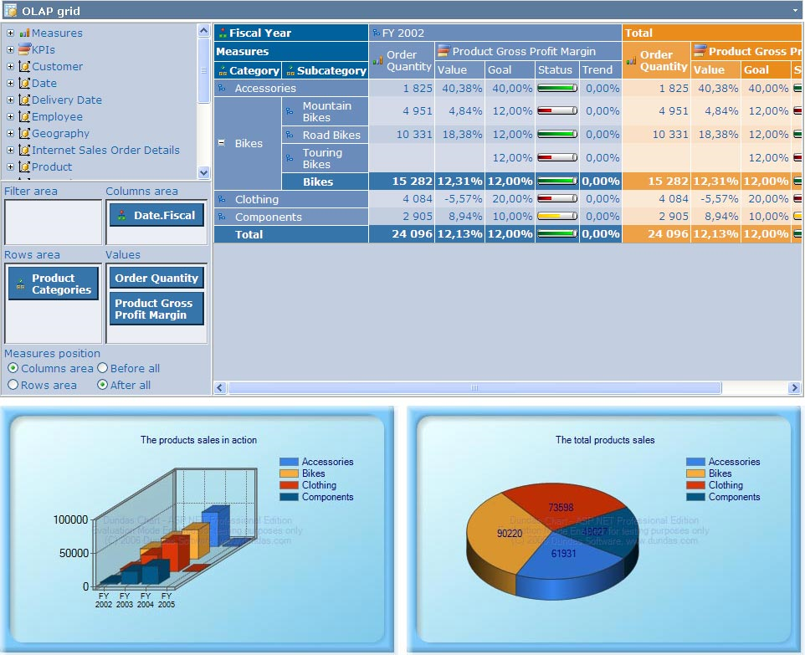
Displaying Multidimensional Analyses

Slide 30
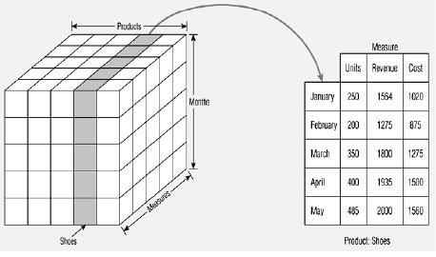
Cube Operations
Slice:
Reduce to n-1 dimensions by selecting a fixed level on the nth dimension
Notes:
Note that “cube” is really only mathematically accurate at exactly 3 dimensions. It is conventional, however, to use ‘cube’ to refer to any multidimensional style data representation.
The multidimensional model of a data value is a useful one.
It asks: “What kind of value do I get for this fact when I have these n dimensions each with the indicated attribute level”
However, it is often instructive to also look at subsets of the whole cube
For example, if you consider the Location X Product X Time sales table,
a product developer might be most interested in focussing on a particular product (i.e. a single level of the Product dimension) across location and time
a sales manager might be interested in a particular store (i.e. a single level of the Location dimension) across the product and time dimensions.
Multidimensional databases can do this.
It is called “slicing”. Taking a single n-1 dimensional data slice out of an n-dimensional cube
Here we have selected out only the ‘shoes’ product

Slide 31
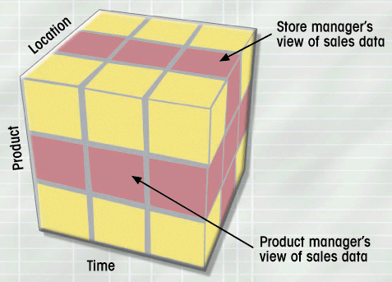
Cube Operations
Slice
Notes:
Different slices answer different questions

Slide 32
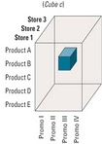
Cube Operations
Dice
Notes:
They can also look at only a subset of the cube. Looking at all n dimensions, but for only some of the attribute values.
This would be like cutting out a chunk of the cube, and is called “dicing”

Slide 33
Cube Operations
Drill Down and Roll Up
Some attributes form natural hierarchies
Country->Province->City->Store
Year->Month->Week->Day
OLAP analyses can selectively collapse across the hierarchy (roll up) or break a more general attribute into its components (drill down).

Slide 34
Data Mining
Advanced statistical techniques for automatically detecting patterns in the OLAP database.
Uses artificial intelligence, expert system and machine learning methods
Results can be used to predict the response of data to manipulation of dimension attributes.
Successful commercial products exist. (For example, Advanced Scout used by majority of professional NBA teams.)
Notes:
Cube analyses are interesting, can be useful, and are probably lots of fun
But in reality, they are only summaries – just descriptive techniques
Also, they are user driven. That is, the user specifies exactly what dimensions s/he wants to observe the effects of
Currently an active area of research (really just the last couple of years) are techniques that go way beyond that
These are ‘data mining’ methods.
These use advanced statistical methods to roam around in the data and come up with patterns
For example, data mining can tell you which animals are most likely to suffer from a change in habitat, or which customers are most likely to move to another provider or which borrowers are most likely to default on their loans, etc.
Sadly, most of these methods are too complex for us to deal with here, but we’ll take a quick look at one of the easiest ones here.
If you want to learn more, I recommend the LaRose book.

Slide 35
Decision Trees
A bank wants to be able to predict who will be a good credit risk.
They have a large database with many values for many previous borrowers, including whether each has ever defaulted on a loan.
Decision tree analysis uses those data to provide a predictive structure

Slide 36
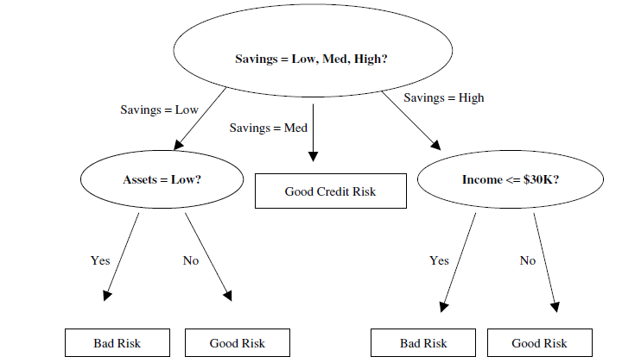
Decision Trees
Assume metrics Savings, Assets and Income
Notes:
Your system might produce a decision tree such as the one shown (LaRose)
Note that the system generates the tree entirely without human intervention
You don’t need to place value on these levels – the system discerns the pattern automatically from the data you give it
So you would walk through and decide whether to give the loan
We see, not surprisingly, that someone with no savings and no income is a bad credit risk
But, less obviously, someone with high savings and low income is also a credit risk. People who fit that description in the data tended to default on loans.
Why?
No idea. Data mining tells you what, not why.
Understanding and explaining the results, as with all statistical procedures, requires humans.

Slide 37

Decision Tree Algorithms
Attempt at each step to recursively divide the data set into groups so that:
The records in each group are as similar as possible
The groups are as distinct from each other as possible
There are mathematical formulae that measure these two things simultaneously
Notes:
There are different ones, and they will give different trees
For example, some produce only binary trees (no more than two children) while others allow multiple branches
They all follow the same basic principles
Looking very briefly at the formula, which is for an algorithm that builds binary trees
A split gets a theta
The theta is the product of the two terms 2PlPr and the sum term
Pl and Pr are the proportion in the left and right groups. This is maximised when neither group is really small. That is, it’s not useful to make a split that puts 9999 records in one group and 1 record in the other. You want greater discriminability
The summation term looks at each class j (in this case good loan or bad loan) and compares how many are in each of the children. Ideally you want all of them in one child, and correctly that’s what maximises this term.
The algorithm starts with the whole set and makes the split that maximises theta. Then it recurses on any node that isn’t all one type of record until it can’t make any more splits (i.e. each leaf node is identical on the metric)

Slide 38
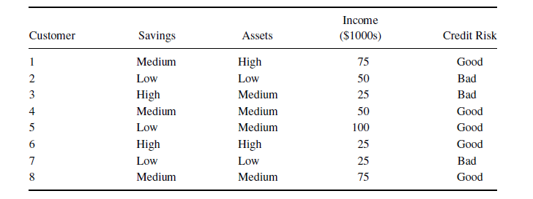
Decision Tree Algorithms
Notes:
For example, with this set of training data, the largest theta you can get is by splitting on Assets(low) vs Assets (medium or high)

Slide 39
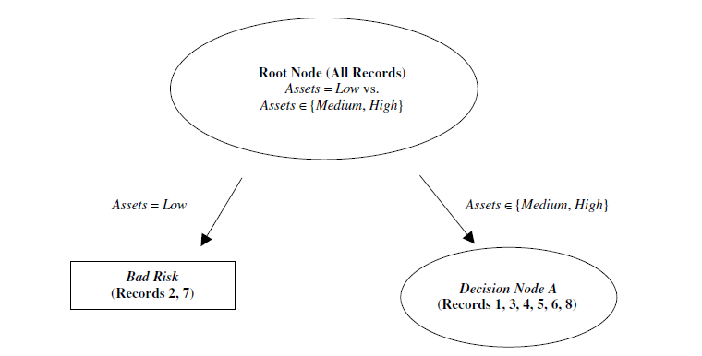
Decision Tree Algorithms
Notes:
This results in two sets.
The Assets(Low) records were all bad loans, so that node is finished
The other set is a mix, so we apply the algorithm recursively to that set.
For this we find the maximum theta is Savings(high) vs Savings(low, medium)
This produces the next step in the tree derivation...

Slide 40
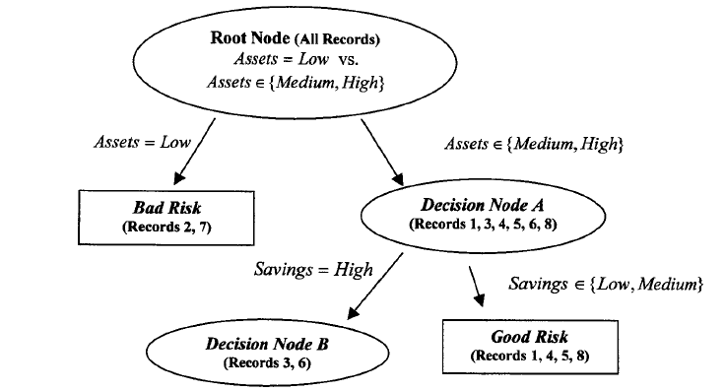
Decision Tree Algorithms
Notes:
Now all the records in the far right node are homogeneous
The lower left child is not so we split again

Slide 41
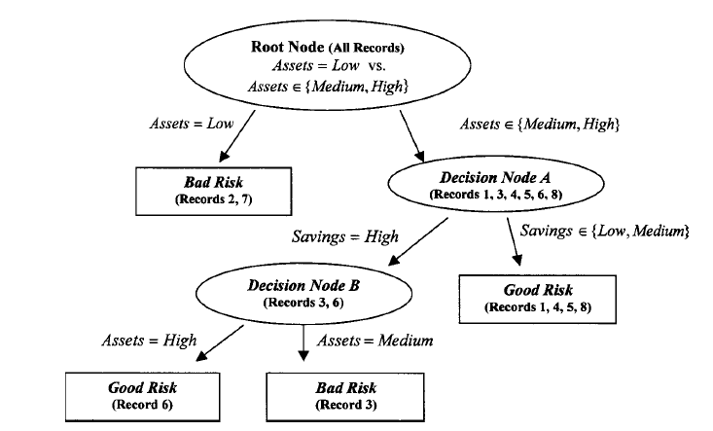
Decision Tree Algorithms
Notes:
The final tree
Using this is easy. You just walk it
Is it perfect? Will you never make a bad loan? Or never turn someone down who would have repaid?
No, of course not.
It is simply a method for quantifying the patterns in existing data
A data mining application can do this kind of analysis on millions of records and thousands of attributes
It can eliminate those that do not discriminate
This would be extremely difficult to do by hand.

Slide 42
Clustering
Algorithms which take a set of input cases and classify them into groups of similar cases.
Applications:
Medical diagnosis
Machine vision
Satellite image processing
Marketing
Category search algorithms
Speech recognition
Zoology (group identification)
Social network analysis
Human genetic group mapping
Fraud detection (similarity)
City Planning
Earthquake prediction
Notes:
The results can be used directly to identify underlying groups, or for prediction.
For example, after classifying based on training data, we can look at the input values for a test case and see into which group it falls.

Slide 43
K-Means Clustering Algorithm
Given a group of data points, separate them into k natural groups.
Mathematically, we wish to assign groups so as to minimise the sum of distances from each data point to the centre of its cluster.
Notes:
There are many algorithms for identifying clusters, but this one is very well-known and easy to code up.
Our example is in 2D space because it’s easiest to look at, but the algorithm extends without modification to n-dimensional space.

Slide 44
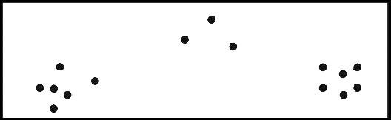
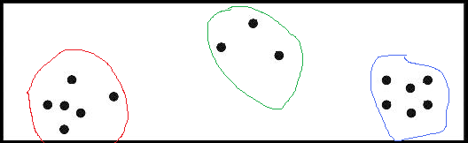
K-Means Clustering
Notes:
For some data sets, you can tell by eye what points are grouped

Slide 45
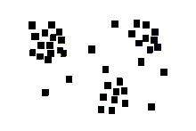
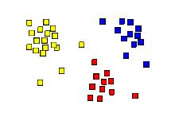
K-Means Clustering
Notes:
Here you can still almost do it by eye…

Slide 46
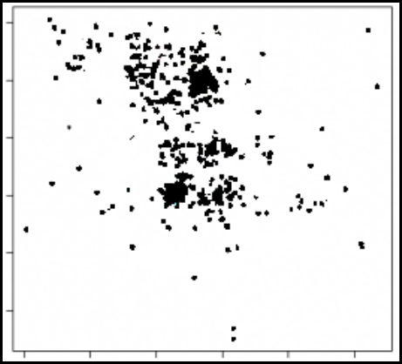
K-Means Clustering
Notes:
But when things get complex….
for example, with this data set, how can you divide these points into groups so as to minimise the sum of the squared differences from the geometric centre of the group?
Not possible by eye.
But the simple algorithm we are going to discuss can do it…

Slide 47
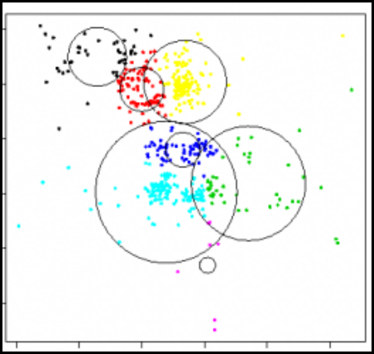
K-Means Clustering
Notes:
…And the groups are like this
Look at the colours to see group membership.
The circles we will discuss later.
Our algorithms will tell us that, mathematically, there are 7 distinct groups in this data set
Depending on exactly what the data are, this may help us to understand the underlying dynamics of the population, or may provide a tool for prediction of group membership for new cases.

Slide 48
K-Means Clustering Algorithm
To create k clusters:
Randomly select k points to be the initial cluster centres.
For each point in the data set, find the nearest centre. The point belongs to that cluster.
For each cluster compute the “centroid”, the geometric centre point.
The centroids become the new centre points.
Repeat steps 2 to 4 until termination condition
Notes:
“Nearest” here is Euclidian distance. d = sqrt(deltax**2 + deltay**2)

Slide 49
K-Means Clustering Algorithm
Termination condition:
No point moves into a new cluster
Reduction in total squared distance falls below some threshold.
Notes:
If condition 1 is met, the groups won’t change anymore
If condition 2 is met, you assume that your grouping isn’t going to improve anymore enough to be valuable, so you quit.
Note that k-means is not guaranteed to find an optimal solution, as it can become stuck in a local minimum.
There are interesting extensions to the algorithm to reduce the probability of this. See refs.

Slide 50
K-means Clustering
Notes:
slides from eniac.cs.qc.cuny.edu/andrew/ml/Lecture7-clustering.ppt
You can see where the clusters should end up.
Let’s watch how the algorithm finds them.

Slide 51
K-means Clustering
Notes:
Looking for three clusters, we randomly selected these three.
for each remaining point, compute the euclidian distance to each centre and group the point with that centre.

Slide 52
K-means Clustering
Notes:
Like so.
Now, compute the geometric centroid of each group.
Take the average of all x coordinate and average of all y coordinates, and that’s the centroid
Looks like this….

Slide 53
K-means Clustering
Notes:
You could compute the SSE here to get a measure of how good your fit was, by taking the distance of every point from its centroid, squaring (to get rid of negatives) and adding them all up.
As you proceed with repeated passes through the procedure, this value should go down.
These locations now become the new centres.
Note that they aren’t locations of actual points in the data set, and that’s ok.
Repeat the step where you compute the distance of each point to each centroid, and group with the closest…

Slide 54
K-means Clustering
Notes:
There are the new groups
Once again compute the centroids…

Slide 55
K-means Clustering
Notes:
Further repetitions will not change any group membership and you’re done.
Could you code this up? (Correct answer: Yes).

Slide 56
K-Means Clustering
What should k be?
Notes:
Remember this data set?
The algorithm found 7 distinct groups.
How, by looking, would you know that there were 7?
Answer: You wouldn’t. If you could tell how many groups there were, you probably wouldn’t need to run k-means.
So, what do you do?
Answer: Add an outer loop. Run the algorithm for k=2,3,…,n
Stop when increasing k doesn’t reduce the overall SSE, or the more sensitive measure BetweenClusterVariability/WithinClusterVariability.

Slide 57
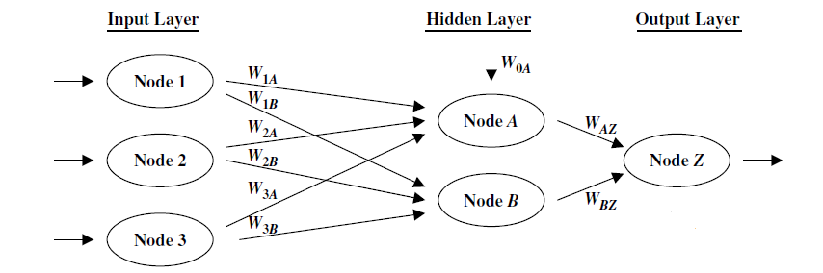
Neural Networks
Notes:
And finally, a completely different machine learning method.
This will take a set of input values (like the decision tree) and generate an output class membership (like the decision tree).
It can be more accurate than the decision tree or any of its common variants.
And at no point, can a person tell on what it is actually basing its decision.
The input nodes are the values from the data set for an individual record
The output node is good loan/bad loan
The hidden layer are just little functions
Each input node has a weighted edge to each hidden node
The hidden nodes compute the weighted sum
They then link onto the output, which computes a sigmoidal (flattened) weighted sum of the hidden nodes
The output node responds with a threshold binary function (a parameter of the model)
The model starts with a random weight on each edge (between 0 and 1)
You feed in each record on the training set one at a time
You compare the generated output to the real one, and feed back, raising and lowering the weights based on some clever maths that basically tries to force the output up or down as required by modifying the weights
Then the next record, and so on
Then you do it all again
Over time, the weights will settle into a set of values that produces the correct output for each record
You can then feed in a new set of input values (a new customer’s data) and watch the output
Note that it doesn’t matter what the weights are, and nobody knows exactly why it works, but it does.
This is called a neural net because it was first proposed as a model of how the brain works, with all the neuron dendrites feeding into a single cell body.

Slide 58
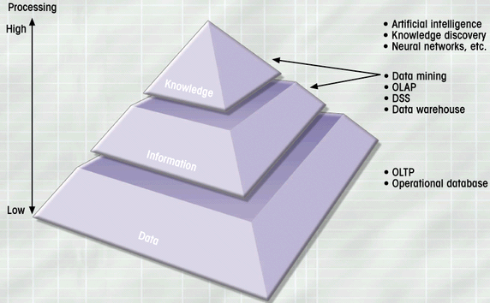
Data Exploration
Notes:
So what is it all for?
This (from Rob and Coronel)

Slide 59
Practical and Reading
Readings on I drive
Practical – SQL Server’s OLAP tools and RapidMiner
Notes:
We will do this practical in the first session next week
Over the weekend, please do the reading.

